Slide 1
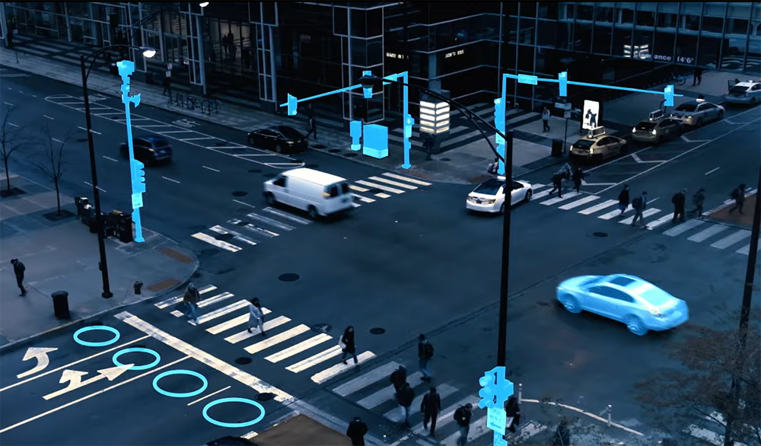

AI Based Smart Traffic Vendor Project
https://smcorridornews.com/austin-to-pilot-smart-city-technology-to-improve-congestion/
Smart Traffic Vendor Project
-Yashaswi Ranga Sivaraju

Slide 2


Today’s presenter
Arizona State University
Yashaswi Ranga Sivaraju
- Department of Robotics and Autonomous Systems

Slide 3

What’s in this presentation
Table of Contents:
The Project's Objective
Description of the project
How does this project benefit humanity?
What do we require to make the project a success?
What are the project's deliverables?
What is assumed to be in the project but is not ?
Criteria for Success
Schedule of the Project
What are the Constraints and Assumptions of the project?
Helpful tools and artwork
ASU Presentation Templates
ASU Logos
ASU Fonts
Freepik Website for Logos
Adobe Stock for Pictures
Flaticon for Icons
Smashicons for Icons
Eucalyp for Icons
Cahiwak for Icons

Slide 4


The Project’s Objectives
Compare AI-based Smart Traffic Monitoring Systems from Various Vendors. The primary vendors we intend to compare are
NoTraffic
Miovision
Wavetronics
Iteris
Econolite

Slide 5
This project is a collaboration between COX and the ASU Collaboratory.

Slide 6
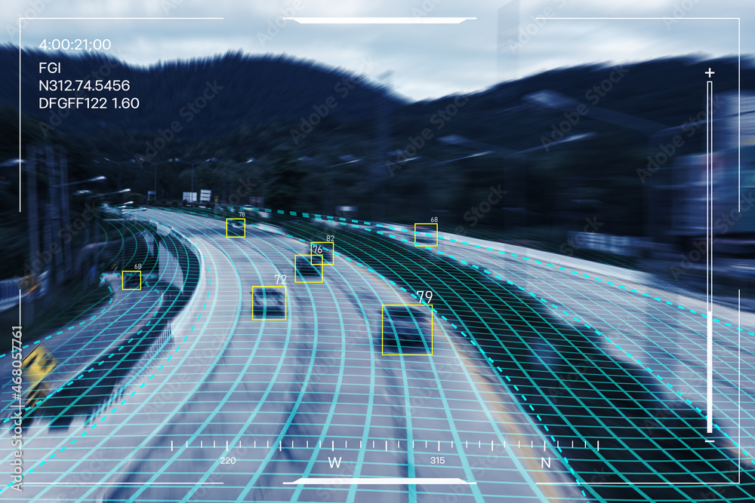
Description of the project
The main evaluation is about Technology, Performance and Economic Benefit Analysis
Other factors are Road Congestion Index, Road Safety Index, Emissions Index
Methods to compare the above mentioned include BOM, MTBF, MOTA, MOTP
Other vendors in the market include : Rhythm Engineering, Flir, ARGOS Vision - Italy, Gridsmart, Rapidflow-Surtrac, Kimley Horn - Kadence, TransCore - ACDSS

Slide 7
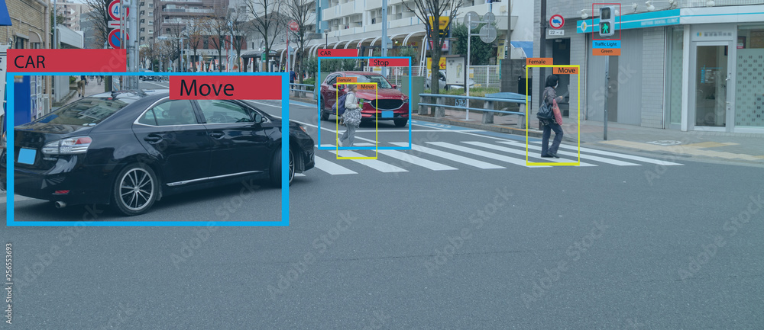
How does this project benefit humanity?
Current Stage of Development
Helps the State Department Of Transport(DOT)
Efficiency with which the system works
Giving humans to concentrate more on other important tasks rather than waiting in traffic

Slide 8
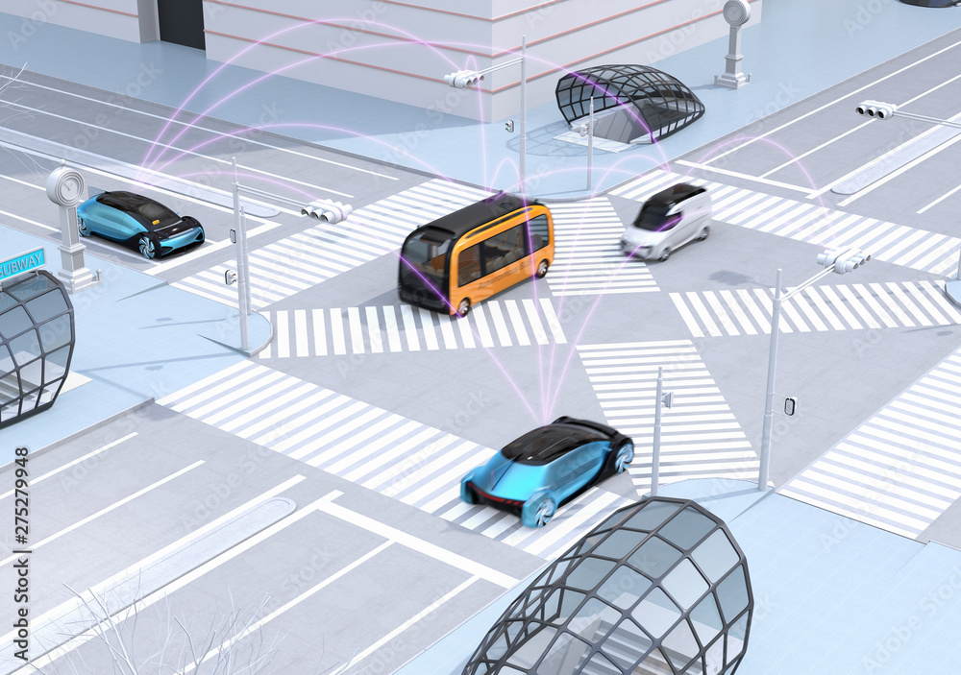
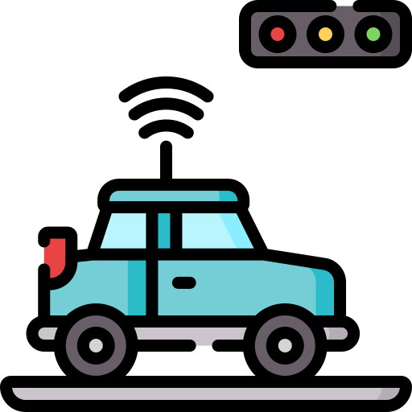

What do we require to make the project a success?
Funding to buy the products from the vendors
Hardware and Software from the Vendors
Previous training, testing data the vendors have and the outputs based out of that

Slide 9


What are the project deliverables?
A White Paper comparing various vendors in the market manufacturing AI Based Smart Traffic Systems

Slide 10

What is Assumed to be in the project but is not ?
Hardware and Software changes in the system
AI Based testing and development

Slide 11
Criteria For Success
Testing the Smart Traffic Devices
Publishing a White paper

Slide 12
Schedule
Estimated Project Schedule
1. Project Start 5 August 2022
2. Scope Statement 2 September 2022
3. Research on Florida’s DOT’s policies 15 September 2022
4. Updates from the Vendors 20 September 2022
5. Literature Review and Vendor Platform Purchase 30 September 2022
6. Creating a Set-Up for Evaluation 10 October 2022
7. Evaluating Vendor Technologies Performance 30 October 2022
8. Preparation Studies for Performance Evaluation 25 November 2022
9. Scientific White Paper Drafting 1 December 2022
10. White Paper Review 20 December 2022
11. Deliver Final report / Presentation 30 December 2022
Total Estimated Length of Project 147 Days (21 weeks)

Slide 13
What are the Constraints and Assumptions in the project?
Constraints:
Delay in response from the vendors
High Cost for procurement
Assumptions:
Devices are ready for full time implementation
Secured in terms of the data exchanged

Slide 14
Q&A

